Slide 1

Survival Analysis
DSLA Course
Rohit Padebettu

Slide 2
Survival Analysis
Everything exists in time
a.k.a.
Time-to-Event Analysis

Slide 3
Clinical Trials – Drug Efficacy
“Survival Analysis” is a technique long used in health sciences

Slide 4
Customer Life Time Value
It enables asking questions like
How much time
before an event occurs,
if it occurs?

Slide 5
Survival Analysis
A set of statistical techniques where the outcome variable is the time until occurrence of an event of interest

Slide 6
Applications
Reliability Analysis in Engineering
Failure in Mechanical Systems
Time to lapsing of policy
in Insurance
Default Risk Analysis
Understand which customers are more likely to default and by when
Event History Analysis
in Sociology
like occurrence of disease, death, marriage, divorce
Customer Churn Analysis
in Education & Business
Understand which customers are likely to switch, drop off and when
Time events to critical events
in Public Sector

Slide 7
Churn vs Survival

Slide 8
Linear Regression -> Logistic Regression
Can the Probability be less than Zero ?
Loan Default Probability

Slide 9

Logistic Regression
Here we model the
Success/Failure Ratio
Or
“Odds Ratio”
What if the data were incomplete/censored as in Clinical Trials?
How do we model time effect?

Slide 10

What is Censoring?
X

Slide 11
What is Censoring in Data Science?
Right censoring is most common in defined period studies
What if customer leaves next day?
What if person has a heart attack next day?
What if the car never comes for its first service?

Slide 12
Logistic Regression
Logistic Regression would give a biased prediction if Censoring isn’t accounted for
Survival Analysis

Slide 13
Survival Curve
Survival Curve of patients undergoing different forms of Cancer Therapy

Slide 14
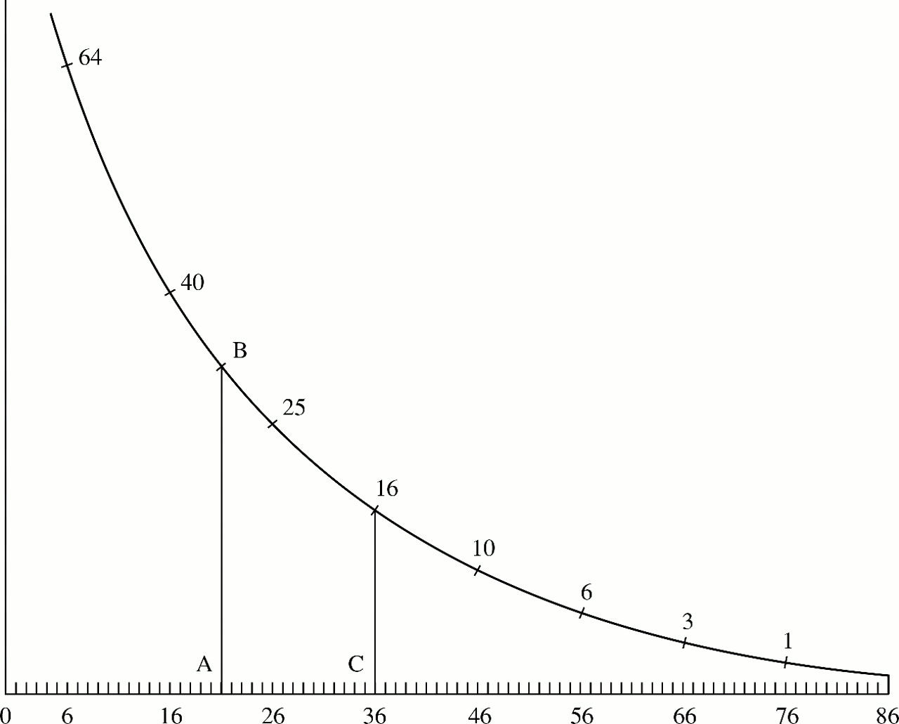
What is Survival Analysis?
Roughly, what shape is this function?
What was a person’s chance of surviving past 20? Past 36?
This is survival analysis! We are trying to estimate this curve—only the outcome can be any binary event, not just death.

Slide 15
Descriptive Survival Analysis

Slide 16
Survival Curves
Censoring

Slide 17
Failure Rate
Failure = 1-Survival
Failure Rate = Slope of that Failure Curve

Slide 18

Hazard Rates
The probability that if you survive to time ‘t’, you will succumb to the event in the next instant.
It is the instantaneous rate of the event happening
Slope of the Survival Curve
$$h\left(t\right)=− \frac{S′(t)}{S(t)}$$

Slide 19
Hazard Models

Slide 20
Kaplan Meier – Non Parametric Model
Non-parametric estimate of the survival function.
Commonly used to describe survivorship of study population
Commonly used to compare two study populations.
Intuitive graphical presentation.

Slide 21
Survival Data (right-censored)
Subject A
Subject B
Subject C
Subject D
Subject E
X
1. subject E dies at 4 months
Beginning of study
End of study
→ Time in months →

Slide 22
Corresponding Kaplan-Meier Curve
100%
Probability of surviving to 4 months is 100% = 5/5
Fraction surviving this death = 4/5
Subject E dies at 4 months
→ Time in months →

Slide 23
Survival Data
Subject A
2. subject A drops out after 6 months
Subject B
Subject C
X
3. subject C dies at 7 months
Subject D
Subject E
X
1. subject E dies at 4 months
Beginning of study
End of study
→ Time in months →

Slide 24
Corresponding Kaplan-Meier Curve
100%
Subject A drops out (Censored)
Fraction surviving this death = 2/3
Subject C dies at 7 months
→ Time in months →

Slide 25
Survival Data
Subject A
2. subject A drops out after 6 months
Subject B
4. Subjects B and D survive for the whole year-long study period
Subject C
X
3. subject C dies at 7 months
Subject D
Subject E
X
1. subject E dies at 4 months
Beginning of study
End of study
→ Time in months →

Slide 26
Corresponding Kaplan-Meier Curve
Product limit estimate of survival
P(surviving interval 1/at-risk up to failure 1)
*
P(surviving interval 2/at-risk up to failure 2)
100%
4/5 * 2/3 = 0.5333
→ Time in months →
Notes:
The probability of surviving in the entire year, taking into account censoring = (4/5) (2/3) = 53%
NOTE: > 40% (2/5) because the one drop-out survived at least a portion of the year.
AND <60% (3/5) because we don’t know if the one drop-out would have survived until the end of the year.

Slide 27
Kaplan-Meier Model
Limitations
Benefits
Mainly descriptive
Doesn’t control for covariates
Requires categorical predictors
Can’t accommodate time-dependent variables
No math assumptions about the hazard model.
Suitable for univariate analysis
Simply, the empirical probability of surviving past certain times in the sample (taking into account censoring).

Slide 28
Parametric Hazard Models
Model the underlying hazard/survival function
Assume that the dependent variable (time-to-event) takes on some known distribution, such as Weibull, exponential, or lognormal.
Estimates parameters of these distributions (e.g., baseline hazard function)
Estimates covariate-adjusted hazard ratios.
A hazard ratio is a ratio of hazard rates
2 Components
A baseline hazard function (which may change over time)
A linear function of a set of k fixed covariates that when exponentiated gives the relative risk.

Slide 29
Normal Hazard Model
Assumes the risk of failure increases considerably with time
Ex: Mechanical systems like car

Slide 30
Uniform Hazard Model
Risk of failure increases exponentially leading to constant decline in Survival. Not common in real world

Slide 31
Exponential Hazard Model
Exponential model assumes fixed baseline hazard that we can estimate.
A Constant Hazard Rate is assumed, leading to an exponential decline in survival ex: Lifespan of humans

Slide 32
Weibull Hazard Model
Weibull model models the baseline hazard as a function of time. Two parameters (shape and scale) must be estimated to describe the underlying hazard function over time.
A gamma rate can be adjusted to model a monotonically trending Hazard Rate. Ex: Cancer Survival as risk increases with time

Slide 33
Log-normal Hazard Model
A sigma rate can be adjusted to model a non-monotonically trending Hazard Rate ex: Mortgage Loan Defaults

Slide 34
Semi Parametric Models
Many times we care more about comparing groups than about estimating absolute survival
A very popular and widely used model
Cox Regression
“A Proportional Hazards Model”
Allows Multivariate Analysis
No need to decide this!

Slide 35
Cox Proportional Hazard
The point is to compare hazard rates of groups who have different values for predictors
To estimate relative risk rather than absolute risk
Independent of Time
In cancer studies:
A covariate with hazard ratio > 1 (i.e.: b > 0) is called bad prognostic factor
A covariate with hazard ratio < 1 (i.e.: b < 0) is called good prognostic factor
HR = 1: No effect
HR < 1: Reduction in the hazard
HR > 1: Increase in Hazard

Slide 36
Cox Proportional Hazard
Hazard Ratios: 26% decline in risk for Group B compared to Group A

Slide 37
Survival Analysis in R
Demo

Slide 38
Survival Analysis
Have good rest of weekend!

